Slide 1


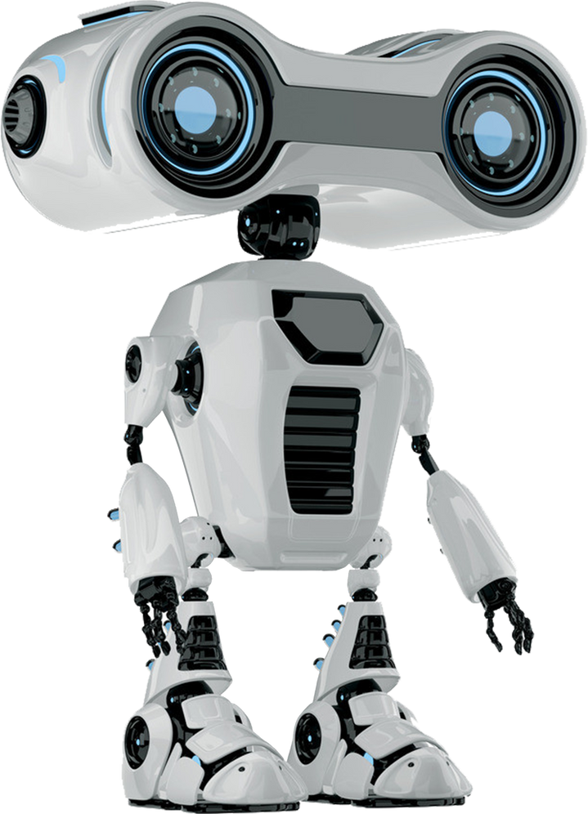
DocuGenAI :
A Technical Documentation Assistant

Slide 2

Objective
Automate technical documentation generation, management, and visualization.
Technologies Used
Programming Language: Python
OpenAI GPT-4 Turbo
ChromaDB (Vector Store)
Streamlit (Frontend)
Plotly, PCA, t-SNE (Visualization)
dotenv, Faker (Environment & Data Generation)

Slide 3

Key Features
Documentation Generator
API Documentation, Code Explanations, Troubleshooting Guides, Code Generation.
Knowledge Base Management
Upload ZIP files with multiple formats (.txt, .md, .json, .csv, .py, .html).
Generate synthetic documentation using Faker.
Retrieval-Augmented Generation (RAG)
Fetch relevant documents for richer, context-driven outputs.
Visualization Module
Interactive document similarity maps (PCA, t-SNE with Plotly).
Modern User Interface
Customized CSS enhancements for a polished experience.

Slide 4

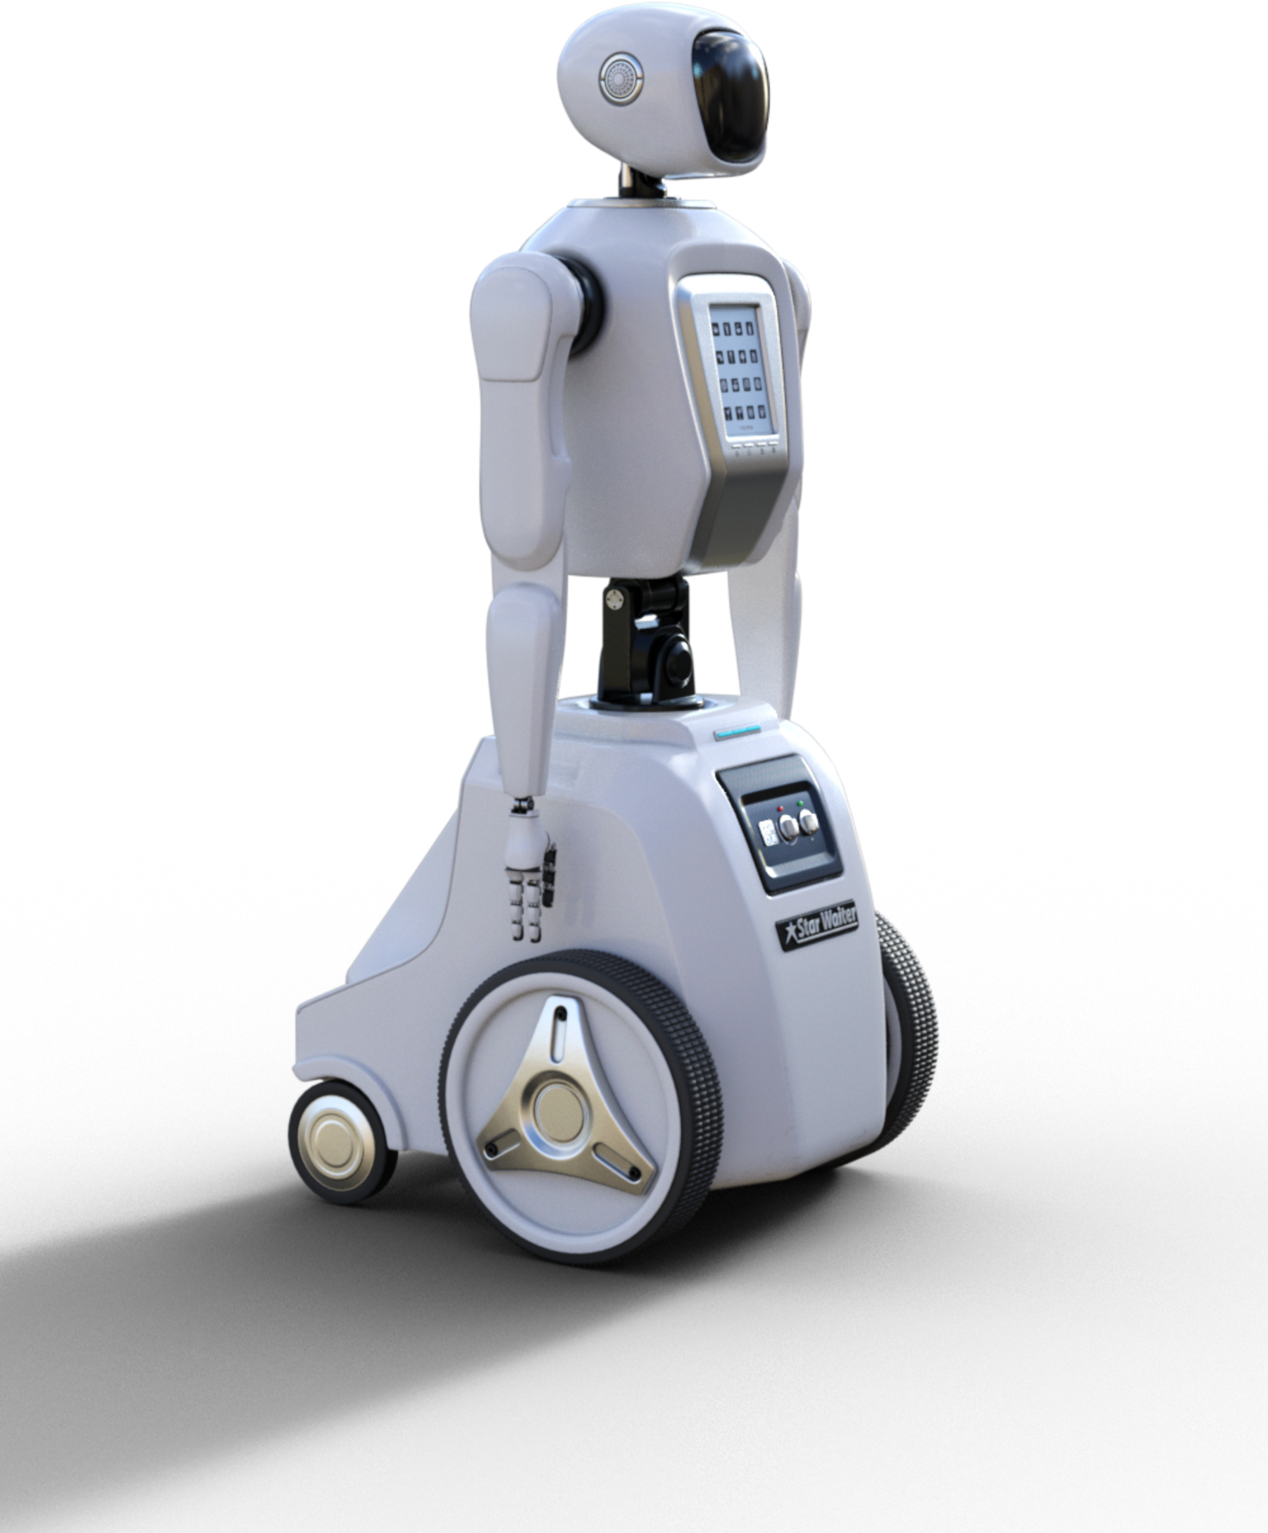
Technical Architecture Overview
Frontend
Streamlit UI with Custom Styling
Backend
OpenAI API Integration
Prompt Engineering & RAG
Document Processing & Synthetic Data Generation
Vector Store
ChromaDB for Persistent Embedding Storage and Retrieval
Visualization Layer
PCA/t-SNE for Dimension Reduction
Plotly for Interactive Charts
Environment Management
dotenv for secure API key and configuration handling

Slide 5

Results and Performance Analysis
Generation Speed
Few seconds per documentation task.
Knowledge Base Scaling
Handles hundreds of documents, including synthetic data.
Accuracy
85% task completion accuracy based on manual evaluations.
Visualization Efficiency
Smooth and quick rendering even with large document sets.

Slide 6
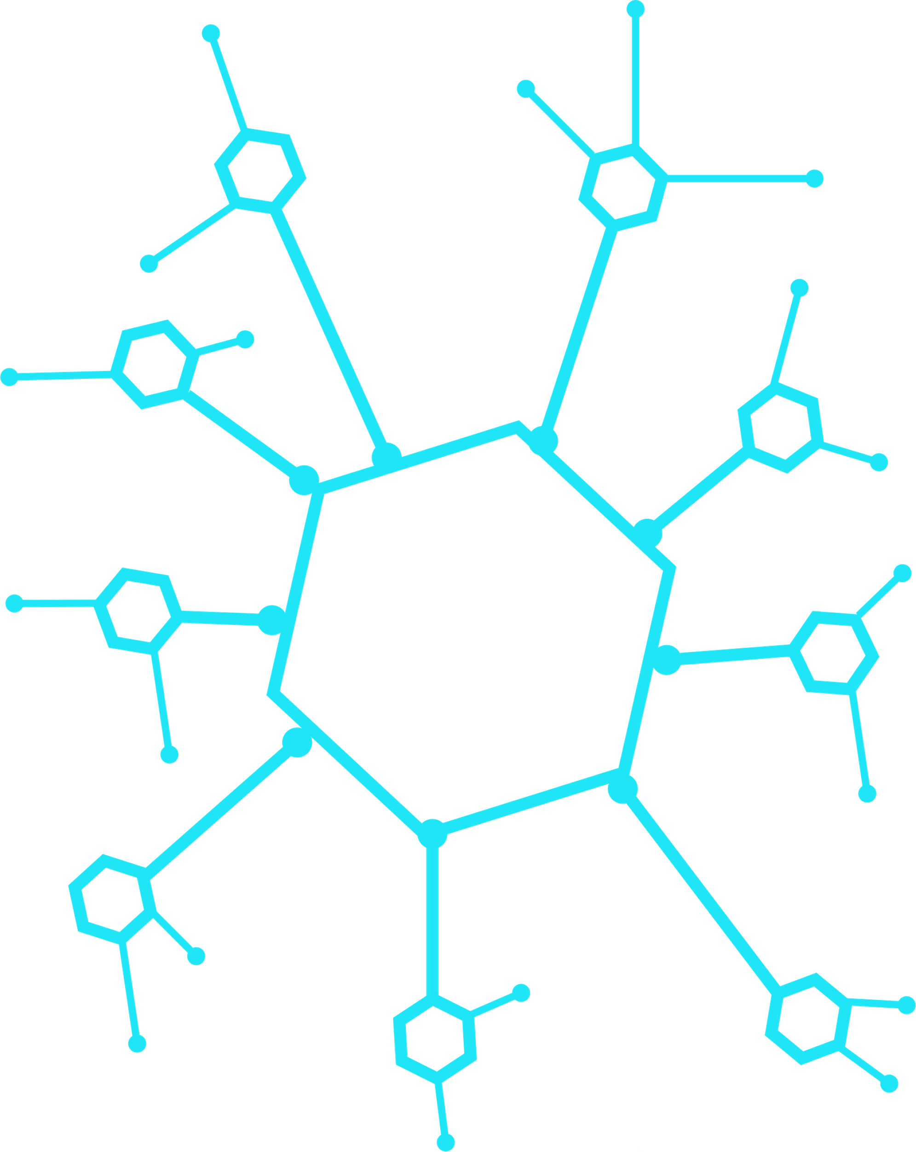
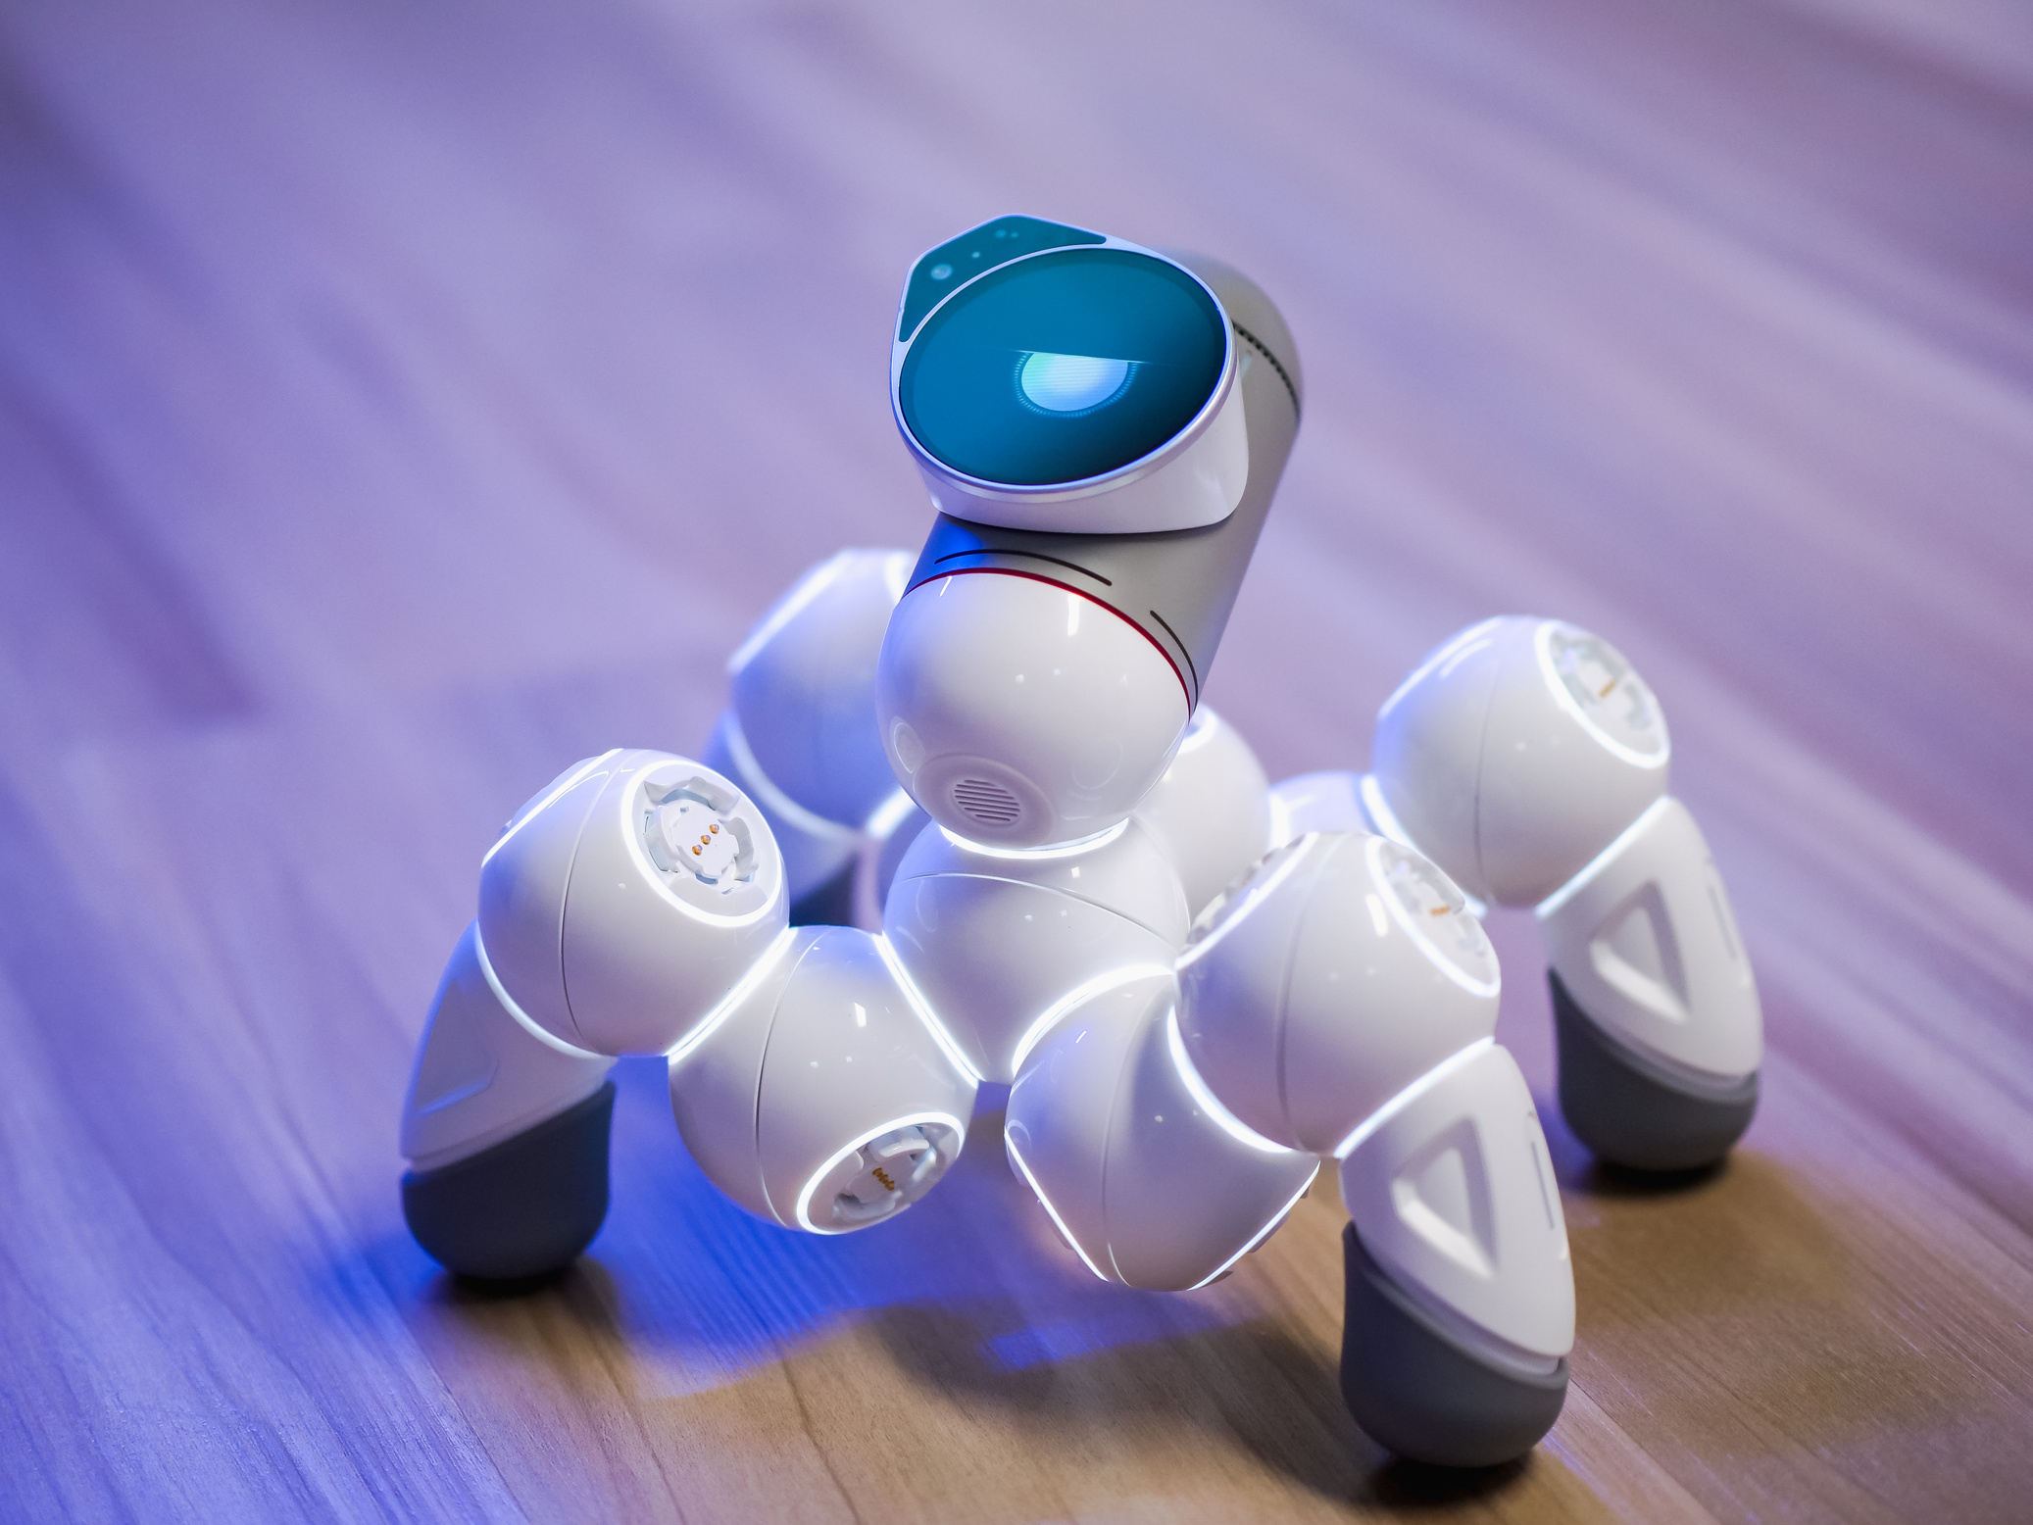

Lessons Learned
Prompt Engineering is Critical
Fine-tuned prompts significantly improved content quality.
Adaptive Visualization
Dynamic t-SNE perplexity adjustment for stability.
Secure API Key Handling
Protected sensitive information using environment variables.
Synthetic Data Value
Boosted system robustness by simulating real-world scenarios.
Future Enhancements
Multi-model integration
Semantic search
User authentication

Slide 7

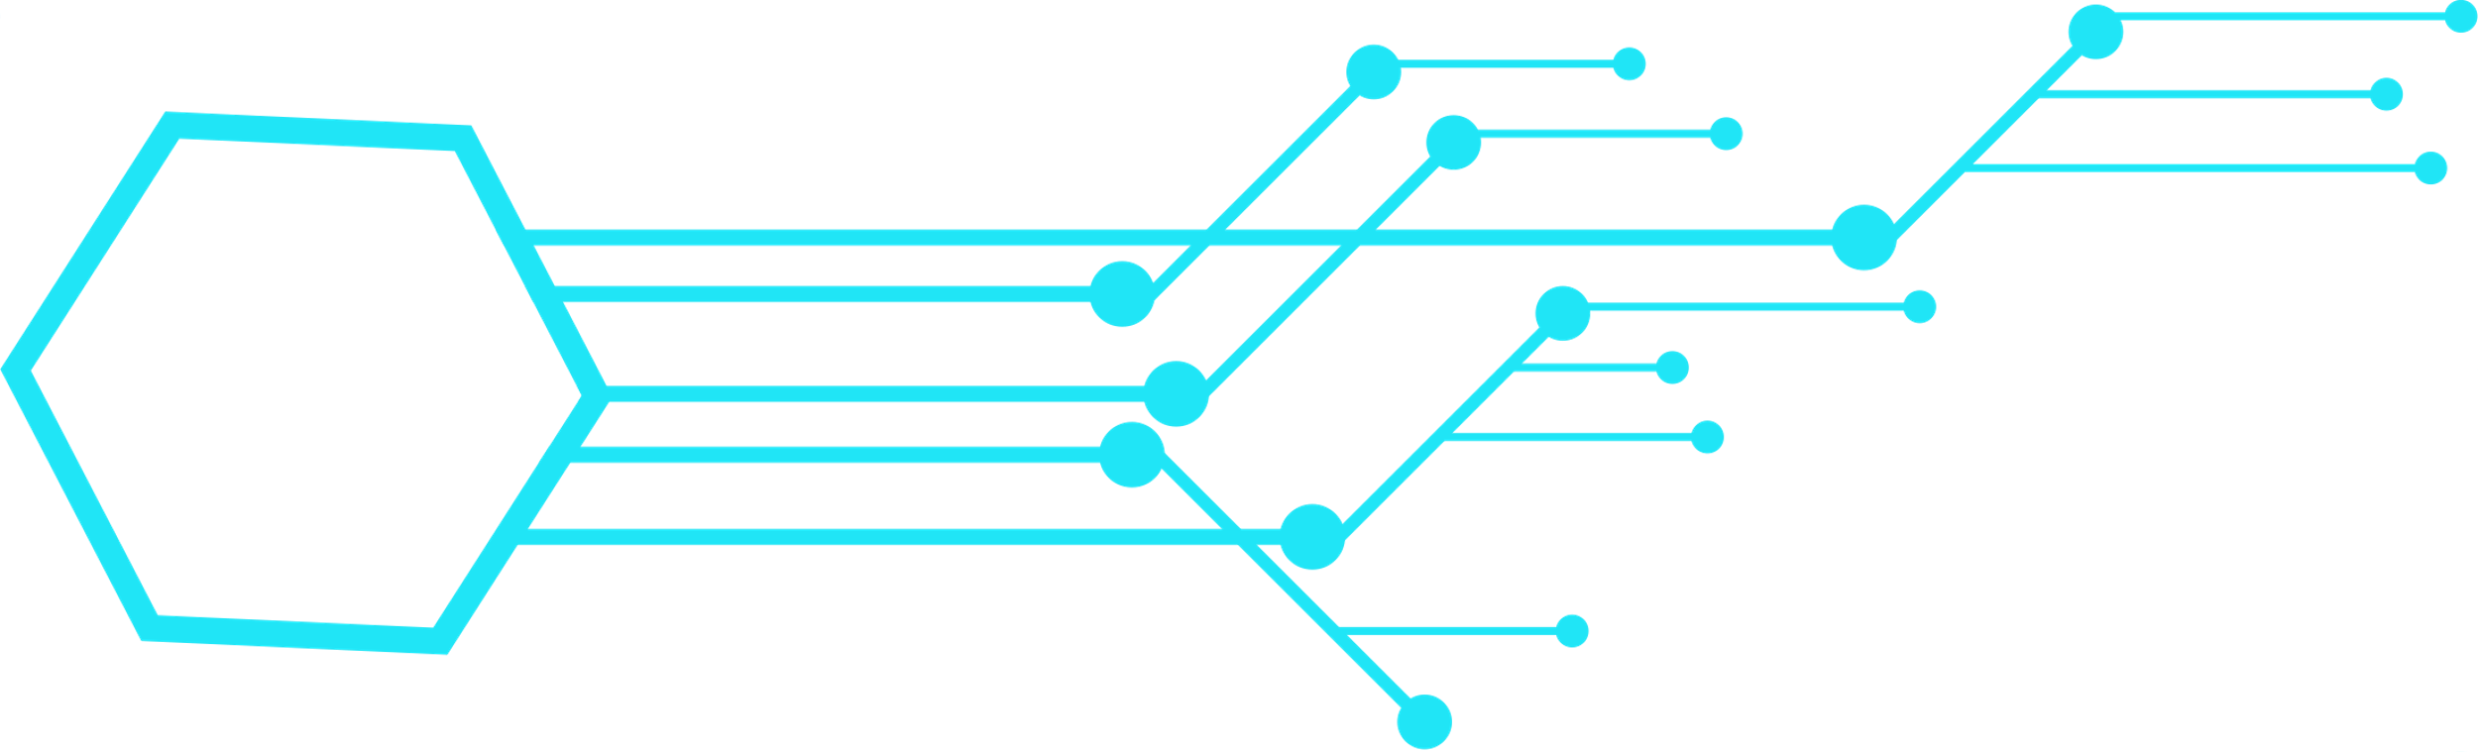
Conclusion
DocuGenAI combines advanced AI, RAG, multimodal integration, and visualization to revolutionize technical documentation.
Impact: Makes documentation creation faster, richer, and more user-friendly.
Next Steps: Expand capabilities with semantic search, multi-model support, and security enhancements.

Slide 8
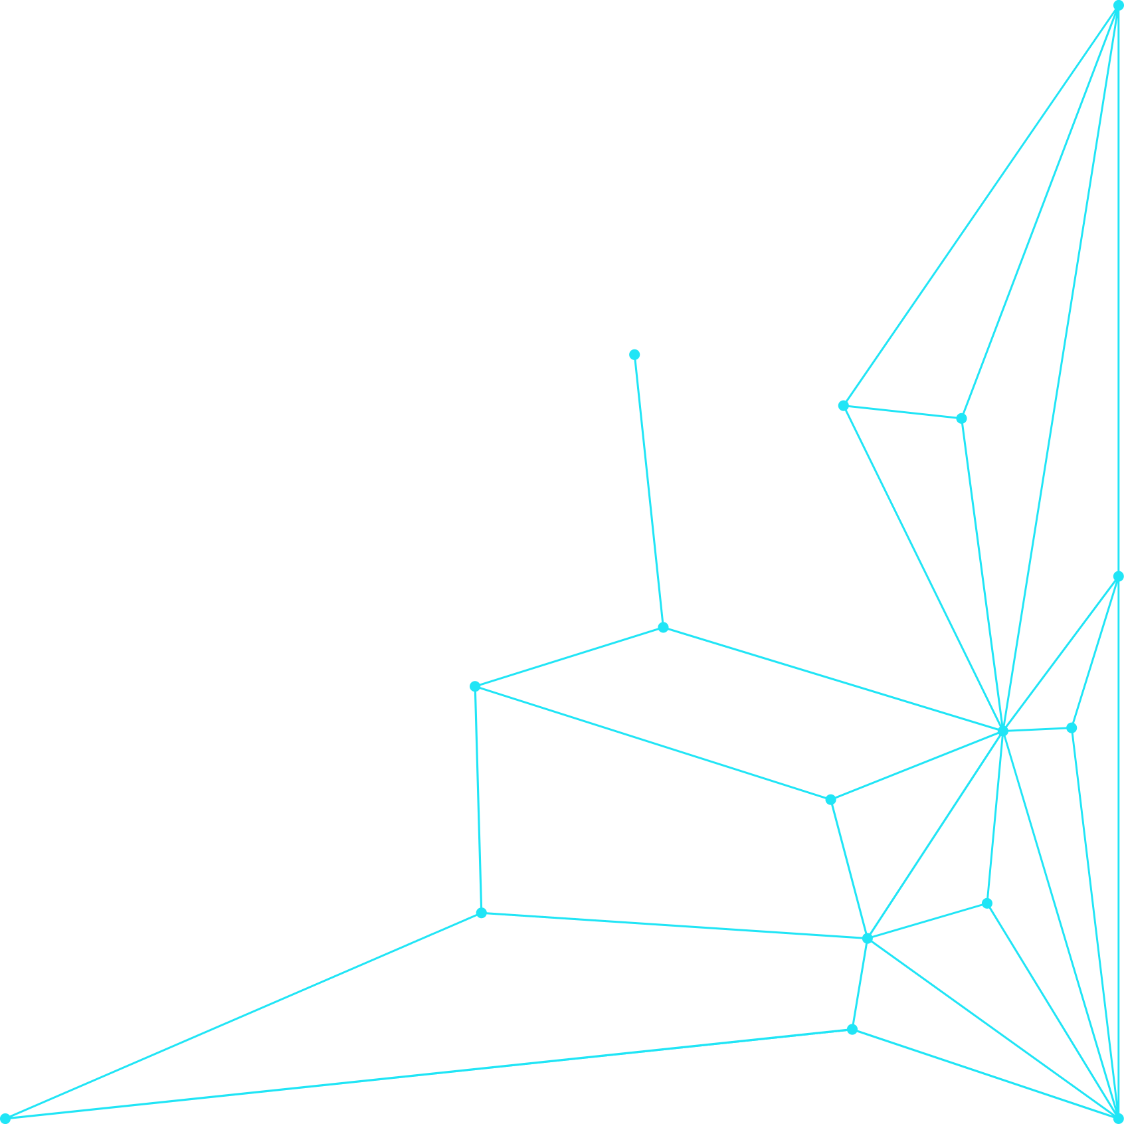

Thank You!
TEAM MEMBERS:
Aseem Deshmukh {NUID: 002743798}
Diya Gandhi {NUID: 002340006}

